Slide 1
Air Pollution Nationwide: assessing trends & contributing factors
Project 3
Group Name: Still Breathing!
Group Members:
Zuhair Shahzad, Saniya Sule, Eric Meyer, Parag Patel, Bhavani Sathya

Slide 2
Objective & METHODS
Analyze the Environmental Protection Agency (EPA) Air Quality Index (AQI) and related data to better understand trends and factors that impact AQI.
Machine Learning Methods Used:
Linear Regression
In multiple linear regression, we predict scores on one variable from the ratings on other variables. The variable we are forecasting is called the criterion variable and referred to as Y. The variable we are basing our predictions on is called the predictor variable and denoted to as X.
Decision Tree
Decision tree makes classification models in the form of a tree structure. An associated decision tree incrementally developed and at the same time It breaks down a large data-set into smaller subsets. The final result is a tree with decision nodes and leaf nodes. A decision node (e.g., Root) has two or more branches. Leaf node represents a classification or decision. The first decision node in a tree which corresponds to the best predictor called root node. Decision trees can handle both categorical and numerical data.

Slide 3
BACKGROUND
Better understand the downward trend in AQI over the last 40 years and assess key contributing factors
Emissions data, ground and air transportation data were analyzed to assess correlation with AQI trends

Slide 4
Data Dictionary
AIR TRAVEL
DEPARTURES PEFORMED: Number of flights
PAYLOAD: Combined weight (in pounds) of all flights in that year
PASSENGERS : Total number of passengers that were on flights in that year
RAMP-TO-RAMP/AIR TIME: Total time flown; either from ramp to ramp or just in air
TOTAL DISTANCE: Total number of miles flown from all flights in that year
GROUND TRAVEL
COMMUTERS(1000s): Number of commuters recorded driven over specified year
DAILY VEHICLE-MILES ON FREEWAY/ARTERIAL STREETS – Average number of miles driven per day on freeways/local roads
FUEL CONSUMPTION(1000 GALLONS) – Amount of fuel consumed by vehicles in a specified year
FUEL EMISSIONS
CITY MPG: miles per gallon driving in the city
HIGHWAY MPG: miles per gallon driving on the highway
TAILPIPE CO₂ (grams/mile): carbon dioxide emissions measured at vehicle tailpipe

Slide 5
DatA Sources
Transportation Dataset:
https://apps.bea.gov/histdata/histChildLevels.cfm?HMI=8
https://mobility.tamu.edu/umr/
Air traffic Dataset:
https://www.transtats.bts.gov/Fields.asp
Data Archive: Gross Domestic Product by Industry and Input-Output Statistics
Agricultural Productivity in the U.S
https://www.ers.usda.gov/data-products/agricultural-productivity-in-the-us/
U.S. Production and Business Activity
https://knoema.com/atlas/topics/Industrial-Production/datasets
https://www.epa.gov/transportation-air-pollution-and-climate-change/accomplishments-and-success-air-pollution-transportation

Slide 6
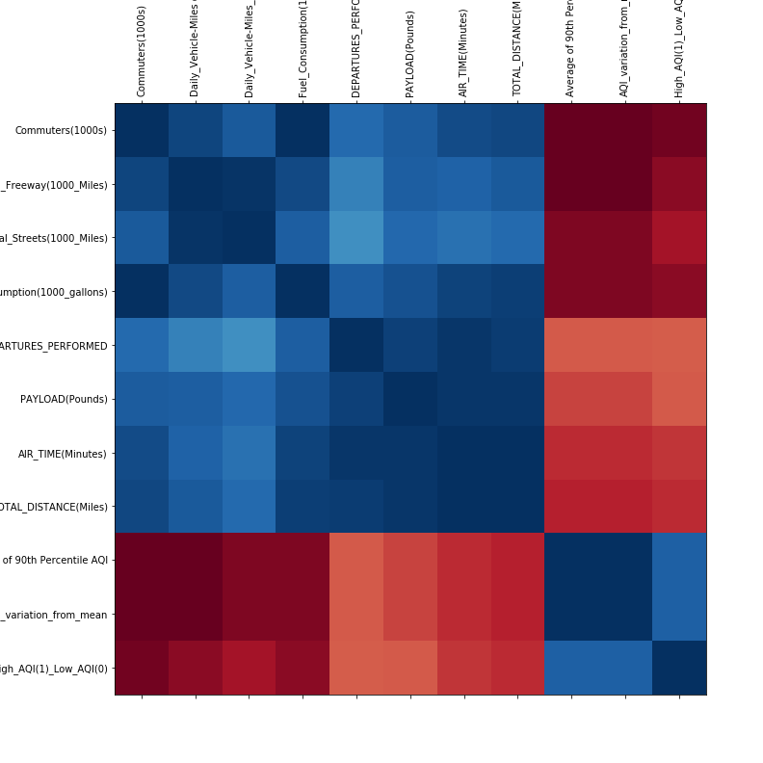
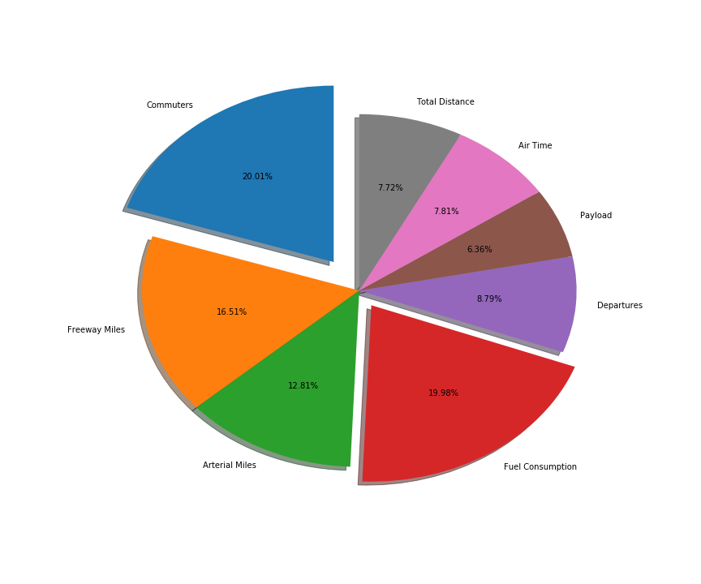
AIR & Ground Transportation
RESULTS – PART I
Despite significant increases noted in number of commuters, miles traveled and fuel consumed for both air and ground travel from 1990 – 2017, the AQI continued a steady decrease
Machine learning model was not very robust in predicting AQI trend
Back to the drawing board

Slide 7
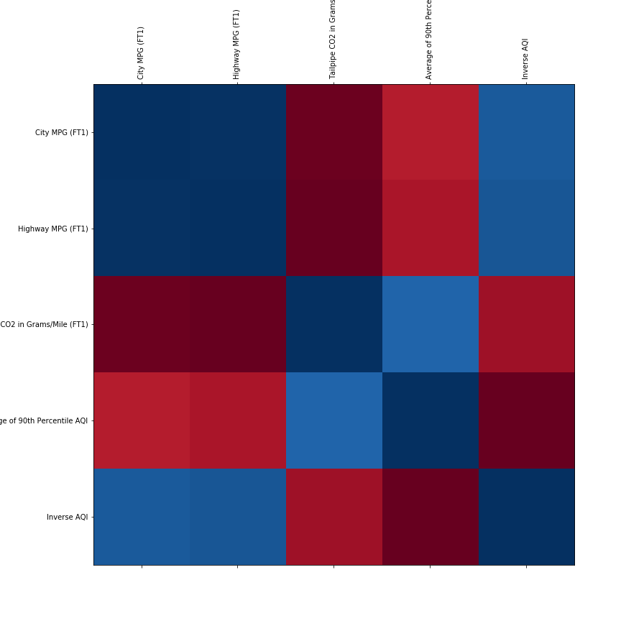
EMISSIONS & AQI
RESULTS PART II
Strong model fit (Training & Testing Scores approach 1)
Linear association between Tailpipe CO2 & AQI, City MPG & AQI

Slide 8
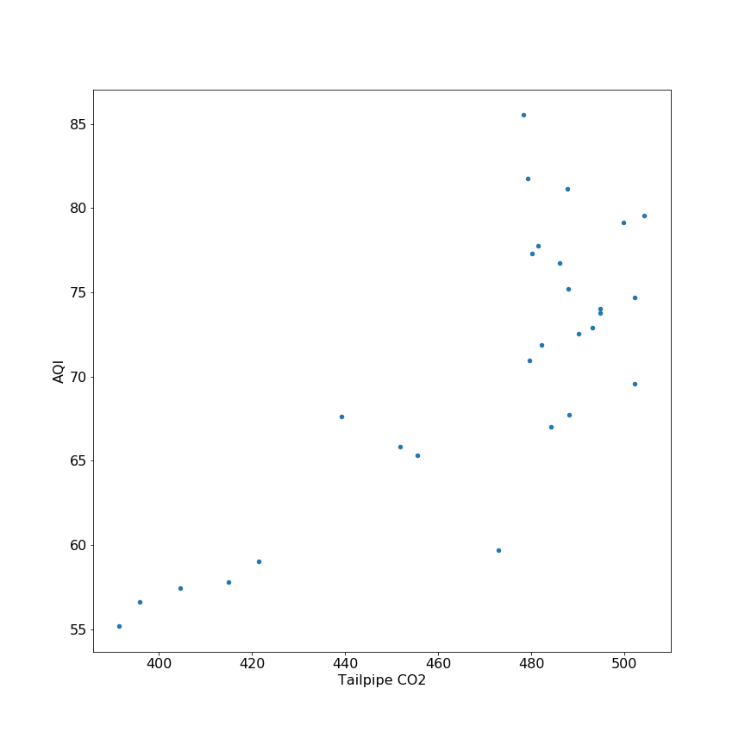
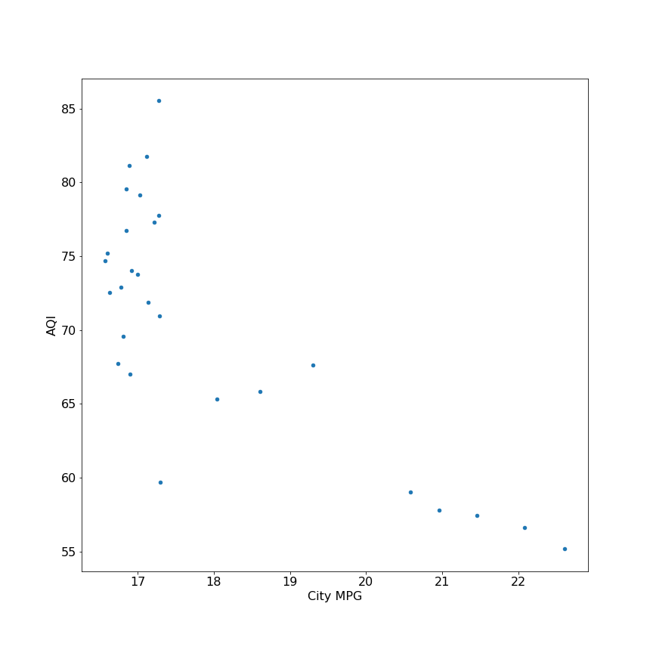
Results Part II

Slide 9
Conclusion
Despite increases in population density, volume and frequency of air and ground travel, and increased fuel consumption, AQI has steadily decreased over time.
Regression models show that emissions standards, increased fuel efficiency (MPG), decreased CO2 emissions have a significant role in keeping overall AQI values low in the united states (despite increases in other factors)
Continued diligence in reducing emissions should be a key strategy in promoting good air quality

Slide 10

Just breathe!!!!

